Slide 1
Information System
ITEC-522
5th Semester Third Year
Information Technology
Dr. Khalil-ur-Rahmen Khoumbati
Professor
Department of Information Technology
Faculty of Engineering and Technology
University of Sindh, Jamshoro
Khalil.khoumbati@gmail.com
Week-1

Slide 2
Course Description
This is a comprehensive subject addressing technical, organizational, and managerial issues confronted by organizational professionals in the selection, implementation, and management of information systems. The course further explores current IS concepts and technologies. Students will learn how information systems give organizations a competitive edge by providing technologies that help managers plan, control, and make decisions.

Slide 3
Course Objectives
1. To demonstrate the knowledge of technical, organizational, and management issues associated with information systems implementation.
2. To understand the knowledge in the selection, implementation, and management of information systems.
3. To formulate planning, integration, evaluation, and support for organization-wide information systems adoption

Slide 4
Continue
To demonstrate how electronic business and commerce, or enterprise systems could support a firm’s business processes, managerial decision making, and strategies for competitive advantage
5. To understand issues contributing to security, integrity, ethics, successful planning, implementation and management of information systems.

Slide 5
Learning Outcome
1. Understanding the process for aligning and organization’s IT objectives with business strategy.
2. Defend the strategic value of information resources for an organization.
3. Participate in an organization’s information systems and technology decision-making processes.
4. Identify ways information systems & technology may improve an organization’s performance, including improving organizational processes, decision-making, collaboration, and personal productivity.

Slide 6
Learning Outcome
5. Define what a manager should be able to expect from an IT department in an organization.
6. Build a business case for IT, addressing key IT acquisition decisions such as make/buy; outsource/insource; project management.
7. Apply a framework for evaluating information-related ethical dilemmas commonly faced by managers.

Slide 7
Course Schedule
Week 1
Course Objectives and Overview
Introduction to Information systems Management
Information Systems Concepts
Systems, Information, Data, Knowledge
Week-2
Information Systems Elements
Week-3
Information systems in Enterprise
Types of information systems
Week-4
Business Process and IS
Organizational Change
Week 5
Enterprise business systems, ERP Systems
Week-6
supply chain systems,
customer relationship management systems.
Week 7
Information Systems in Organizations and Strategy Making
Information Systems in (Global) Business Today
Week-8
How Businesses Use Information Systems : Strategic use of Information Systems in Digital Economy

Slide 8
Course Schedule
Week 9
Information Systems Integration
Week 10
Business Intelligence and Decision Support
Week-11
Systems planning Critical Issue of Organizations
Week-12
Information Systems security and ethical challenges
Week 13
Knowledge Management
Week-14
Trend of IS for growth and advantage of organization
Week 15
Course Revision Overview and Conclusion

Slide 9
Schedule of assessment tasks for students during the semester
Assessment No | Assessment task | Week due | Proportion of Assessment from 100 Marks
1 | Mid-term test | As announced by university | 30%
2 | Student Assingment | 10th week | 10%
3 | Attendance | Full Semester | 10%
4 | Final test | As announced by university | 50%

Slide 10
Reference Material
TEXT BOOK
Laudon K. C. & Laudon J. P., Essentials of Management Information Systems, 15th Edition, Pearson, 2018.
Reference Book
O’Brien J. A. and Marakas G. M., Introduction to Information Systems, 14th Edition, McGraw-Hill Irwin, 2012.

Slide 11
Introduction: Information Systems
What is Information Systems
Information system is about the usage of information technology tools by group of people or staff in managing information.
Information system is the collection of technological components, users and data into systems designed to produce information to aid decision making.

Slide 12
Cont.
Information system is an integrated set of components for collecting, storing, processing, and communicating information.
Business firms, other organizations, and individuals in society rely on information systems to manage their operations, compete in the marketplace, supply services, and enhance personal lives.

Slide 13
Why study MIS?
Micro view
  Studying MIS can provide you with essential knowledge to ensure that how company manages information systems with the highest level of efficiency.
Macro view
  Change of paradigm: information age

Slide 14
What is MIS?
M: Management
  Business Functions/Processes, Organizations, and Human Behaviors
I: Information
  Contents: Data, Information, Knowledge
  Processes: Create, Gather/capture/elicit, Store, Organize, Consolidate & Condense, Filter, Deliver, and Share
S: System (Information Systems/Information Technology)
  Input-Process-Output and Storage
  General Systems Theory (GST)
http://en.wikipedia.org/wiki/Management_information_system
http://en.wikipedia.org/wiki/Systems_thinking
http://en.wikipedia.org/wiki/Systems_theory
Notes:
http://en.wikipedia.org/wiki/Systems_theory

Slide 15
What is Management
Management is the process of achieving goals and objectives effectively and efficiently through and with the people.
"Management is a process of designing and maintaining an environment in which individuals work together in groups to effectively and efficiently accomplish selected aims".

Slide 16
What is Information
Information as a concept has a diversity of meanings, from everyday usage to technical settings. Generally speaking, the concept of information is closely related to notions of constraint, communication, control, data, form, instruction, knowledge, meaning, mental stimulus, pattern, perception, and representation.

Slide 17
Cont.
There are several ways to define “information”
  Subjective: People develop models of their environment. Information created by people makes those models more accurate.
  Thing/artifact: Information is what’s captured in a book, web page, or other resource.
    More information is digital

Slide 18
What is System
  A set of elements or components that work together and interact to accomplish goals
    A desktop publishing system is a computer running desktop publishing software.
  A combination of components working together
    a computer system includes both hardware and software.
  An organization or methodology
    The binary numbering system, for instance, is a way to count using only two digits.

Slide 19
System Components and Concepts
System boundary
  Defines the system and distinguishes it from everything else
  Systems are not independent. They are a part of their environments.
  Information systems:generally integrated and interact with other systems.
  But they are not open ended

Slide 20
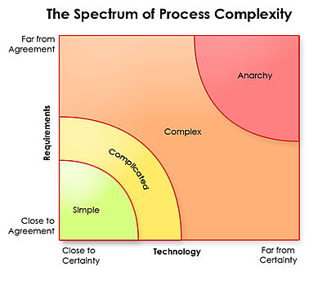
System Types
Simple vs. complex
    Simple systems
      possible to define system outputs from known inputs
      Does not require high level system analysis and review
      Chair, with not moving parts
    A Complex System
      Multitude of parts and relationships
      involves a number of elements, arranged in structure(s) which can exist on many scales.
      go through processes of change that are not describable by a single rule nor are reducible to only one level of explanation, these levels often include features whose emergence cannot be predicted from their current specifications. Ex: Genetic Algorithms, Neural Networks-learn by example.
      Requires high system analysis and review

Slide 21
System Types
  Open vs. closed :
    Open system
      regularly exchanges feedback with its external environment
      porous boundaries through which useful feedback can readily be exchanged and understood.
      continuously exchange feedback with their environments, analyze that feedback, adjust internal systems as needed to achieve the system’s goals, and then transmit necessary information back out to the environment.
    Closed system:
      have hard boundaries through which little information is exchanged. (nearly no interaction with environments)
      Organizations that have closed boundaries often are unhealthy. Examples include bureaucracies, monopolies and stagnating systems.
  orgs-open-systems.pdf

Slide 22
System Types
Adaptive vs. nonadaptive
    Adaptive system:
      Adoptive to environment
      agents (which may represent cells, species, individuals, firms, nations) acting in parallel, constantly acting and reacting to what the other agents are doing.
      ability to recognize the shape of a problem and tailor its responses, changes its behavior based on its environment.
      handle complex problems
    Non-adaptive System
      Fail to adopt to environment
      Steady

Slide 23
System Performance and Standards
Efficiency
  A measure of what is produced divided by what is consumed
Effectiveness
  A measure of the extent to which a system achieves its goals
System performance standard
  A specific objective of the system

Slide 24
System Variables and Parameters
System variable
  A quantity or item that can be controlled by the decision maker
  E.g. the price a company charges for a product
System parameter
  A value or quantity that cannot be controlled by the decision maker
  E.g., cost of a raw material

Slide 25
Why Information Systems?
A Business Perspective on Information Systems
Complementary Assets
Assets required to derive value from a primary investment
Can be organizational, managerial, or social assets
Technology investments supported by investment in complementary assets receive superior returns

Slide 26
Why Information Systems?
Organizational Assets
Supportive organizational culture valuing efficiency and effectiveness
Efficient business processes
Decentralized authority
Distributed decision-making rights
Strong IS development team

Slide 27
Why Information Systems?
Managerial Assets
Strong senior management support for technology investment and change
Incentives for management innovation
Teamwork and collaborative work environments
Management training programs
Management culture valuing flexibility and knowledge-based decision making

Slide 28
Why Information Systems?
Social Assets
The Internet and telecommunications infrastructure
IT-enriched educational programs
Governmental and private-sector standards
Laws and regulations creating fair, stable market environments
Technology and service firms in adjacent markets to assist implementation

Slide 29
Contemporary Approaches to Information Systems
Social Assets
Technical approach: emphasizes mathematically based models, physical technology, and formal capabilities of systems
Behavioral approach: studies issues arising from development and maintenance of systems, such as business integration and utilization

Slide 30
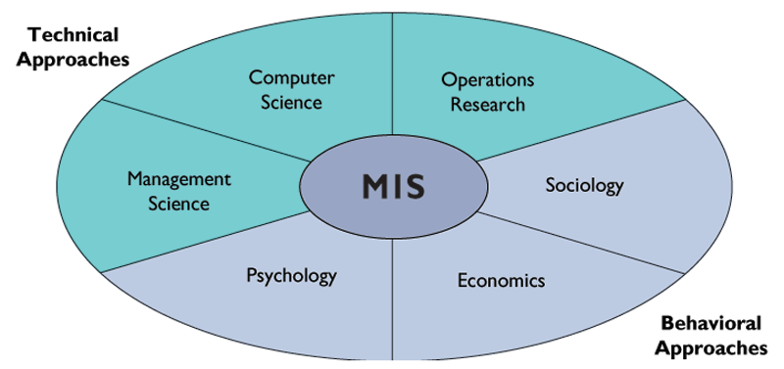
Contemporary Approaches to Information Systems
Contemporary approaches to information systems
Figure 1-8

Slide 31
Contemporary Approaches to Information Systems
Sociotechnical Systems
Management Information Systems (MIS)
System performance optimized when technology and organization adjust to each other for a satisfactory fit

Slide 32
Learning to Use Information Systems
The Challenges of Information Systems: Key Management issues
Positive Impacts of Information Systems
Faster calculations and paperwork
Analysis of customer purchase patterns and preferences
More efficient business services
Medical advances
Instant global distribution of information

Slide 33
Learning to Use Information Systems
The Challenges of Information Systems: Key Management issues
Negative Impacts of Information Systems
Automation leading to job elimination
Privacy concerns
System outages and shutdowns
Health problems, repetitive stress injury
Illegal distribution of intellectual property

Slide 34
Discussion
Questions?

